Slide 1

School of Computer Science & IT Department of BCA
PROJECT CENTRIC LEARNING
Dr. Ananta Ojha, Associate Professor
&
PCL Coordinator

Slide 2
Project Centric Learning
Course Objectives:
The objective of this course is to develop among students an understanding of Research, Innovation and Software Product Development as well as to facilitate an Entrepreneurial Mindset with necessary cutting-edge knowledge and skills vital for generating value in knowledge-based economy.

Slide 3
Course Outcomes
Sl. No. | Course Outcome | Description | Bloom’s Taxonomy Level
1. | CO 1 | Describe the technological / societal trends and its impact on business and living. | Understand (2)
2. | CO 2 | Identify opportunities, and problems in the changing environment. | Understand (2)
3. | CO 3 | Demonstrate engineering knowledge and skills to gather requirements of users and the software application. | Apply (3)
4. | CO 4 | Analyse requirements for a value-added software solution or product | Analyse (4)
5. | CO 5 | Develop the software solution or product to address the needs | Create (6)

Slide 4
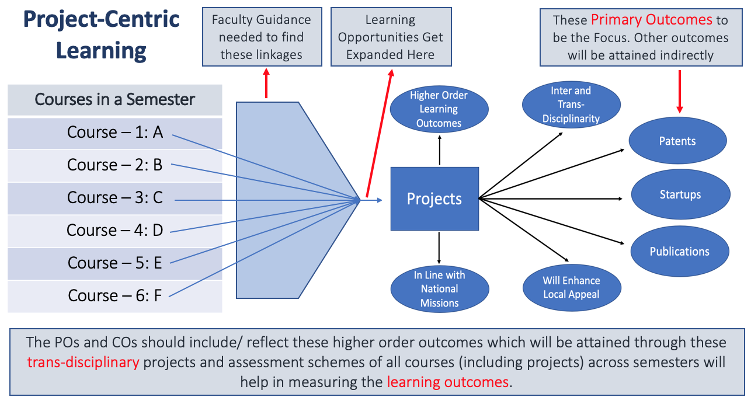

Slide 5
Semester-wise Work
Semester | Project Phase | Guidelines and Activities | Artefacts/ Outcomes | CO
I | IDENTIFICATION OF PROBLEM | Select a Problem Domain Identify / Define the Problem Propose a Title Define Scope and Objectives Write the Synopsis (500-1000 words) | Submission of Synopsis | CO1, CO2
II | DATA COLLECTION | Conduct a Detailed Study/Survey Understand User/customer and Software Requirements Identify S/W, H/W, Tools & Technology requirements Limitations of Existing System Advantages of Proposed system Economic Feasibility Assessment | Submission of High Level Requirements Document | CO3

Slide 6
Semester | Project Phase | Guidelines and Activities | Artifacts/ Outcomes | CO
III | METHODOLOGY (DESIGNING THE SOLUTION) | Requirements Analysis (Use Case Modelling, Sequence Diagram, Activity Diagram, E-R Model, etc.) Requirements Design (Architectural Design, User Interface Design, Class Diagram, Database Design) Modular or Pattern-based designs may be followed Modelling Tools may be used | Submission of SRS and Software Designs Document | CO4
IV | IMPLEMENTATION (CODING) | Better Coding Practices may be followed Suitable IDEs may be used GitHub may be exploited for collaborative development | Submission of Executable Code | CO5

Slide 7
Semester | Project Phase | Guidelines and Activities | Artifacts/ Outcomes | CO
V | TESTING/ MAINTAINENCE | Use Blackbox and Whitebox Testing Strategies Design Test cases Perform Input Validation Preferably use testing tools | Submission of Test Document and Bug-free Software. | CO5
VI | DOCUMENTATION (REPORT) & PUBLICATION | Follow the prescribed format for project report Carryout Publication/Patent (Minimum one Publication ) | Submission of Final Project Report with Software Copy. Paper publication Patent Filing | CO1, CO2, CO3, CO4, CO5

Slide 8
Assessment Scheme
Sl. No. | Assessment Instrument | Formative/ Summative | Frequency | Weightage (%) | Course Outcome
1. | Project Participation | Formative | Continuous | 10 | CO (1-5)
2. | Idea Generation/Innovation Thought Process |  | 1 | 20 | CO (1,2)
3. | Analysis/Design/ Program Execution |  | 1 | 40 | CO (3,4,5)
4. | Report/Paper | Summative | 1 | 30 | CO (1-5)
 | Total |  |  | 100

Slide 9

THANK YOU

